Slide 1


Fast Food Companies: A Deep Performance Analysis
Final Project
Group 11 – Claudio Perrone, Noor Raza, Pau Soler, Timon Weidemann, Eva Li
Python for Data Science – Francisco Javier Marin Tur
18.12.2024

Slide 2


Agenda
Overview
1.1. Project Overview
1.2. Dataset Overview
Data Processing
2.1. Importing Dataset
2.2. Inspect Data Frame
2.3. Cleaning the Dataset
3. List of Exercises
3.1. Exercise 1
3.2. Exercise 2
3.3. Exercise 3
3.4. Exercise 4
3.5. Exercise 5
3.6. Exercise 6
3.7. Exercise 7
3.8. Exercise 8
3.9. Exercise 9
3.10. Exercise 10

Slide 3
1. Overview
1.1. Project Overview
1.2. Dataset Overview

Slide 4
1.1. Project Overview
Step 1
Import & Inspect Datasets
Step 2
Process & Clean Datasets
Step 3
Analyze Datasets
Step 4
Visualize Datasets
Step 5
Gather Insights
Step 6
Push all files & changes on GitHub

Slide 5

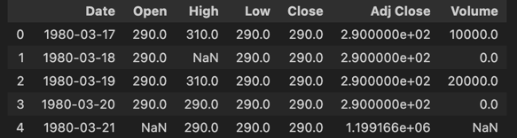

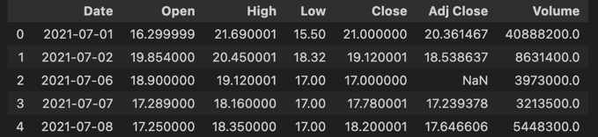

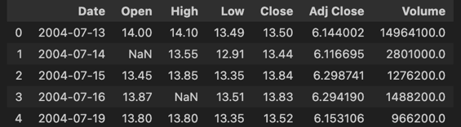

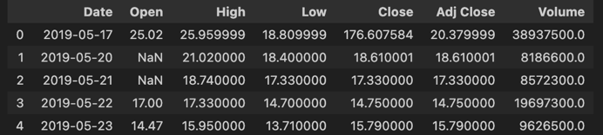

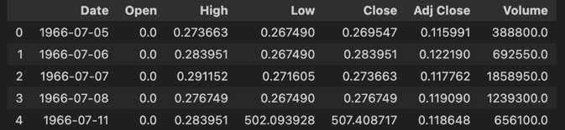

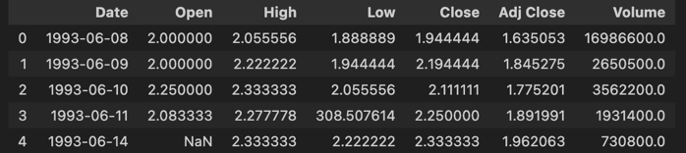

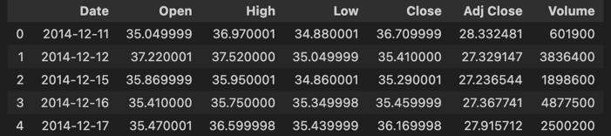

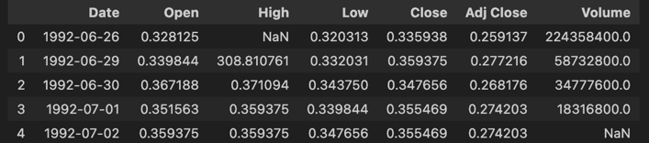

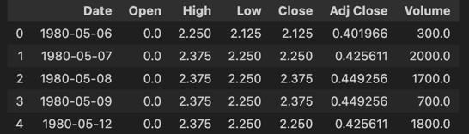

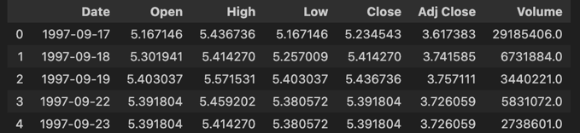
1.2. Dataset Overview
We received the datasets of 10 publicly listed fast-food companies.
Ticker
Company
Logo
Main Brand
Dataset
BRK-A
Berkshire Hathaway Inc.
Dairy Queen
DNUT
Krispy Kreme, Inc.
Krispy Kreme
DPZ
Domino's Pizza, Inc.
Domino's Pizza
LKNCY
Luckin Coffee Inc.
Luckin Coffee
MCD
McDonald's Corporation
McDonald's
PZZA
Papa John’s Intl., Inc.
Papa John’s
QSR
Restaurant Brands Intl. Inc.
Burger King
SBUX
Starbucks Corporation
Starbucks
WEN
The Wendy's Company
Wendy's
YUM
Yum! Brands, Inc.
KFC

Slide 6
2. Data Processing
2.1. Importing Dataset
2.2. Inspect Data Frame
2.3. Cleaning Dataset
2.3.1. Sort Data
2.3.2. Identifying & Removing Duplicates
2.3.3. Visualize Dataset
2.3.4. Removing Outliers
2.3.5. Impute Missing Values
2.4. Exporting Dataset

Slide 7

2.1. Import Dataset
We import the .csv dataset using pandas data frame for each company.

Slide 8
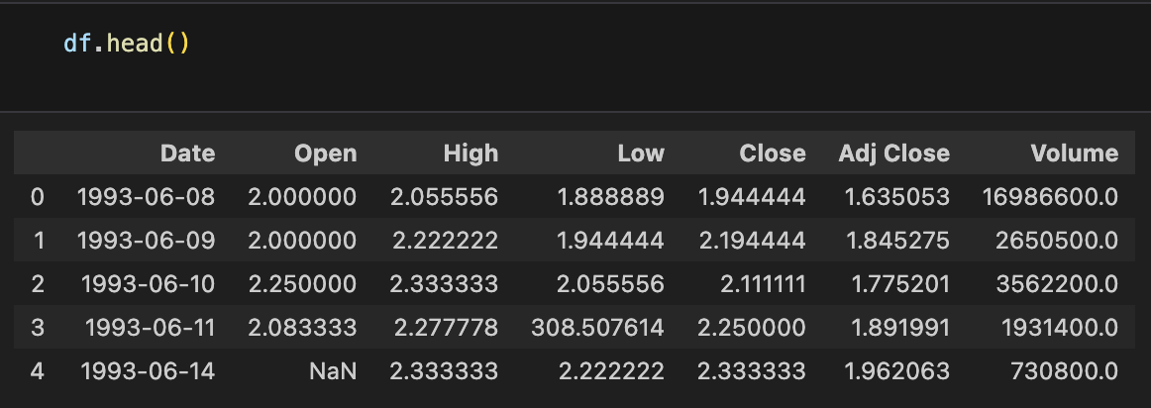
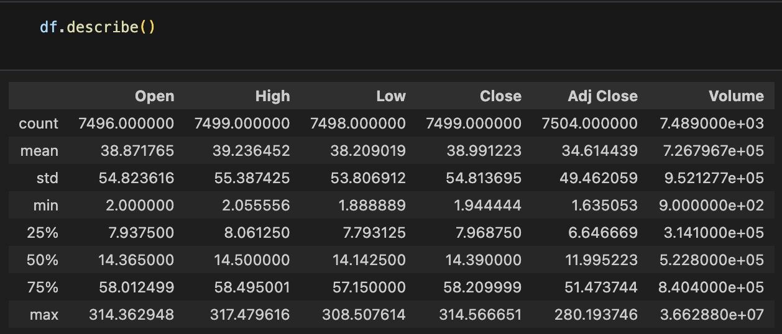
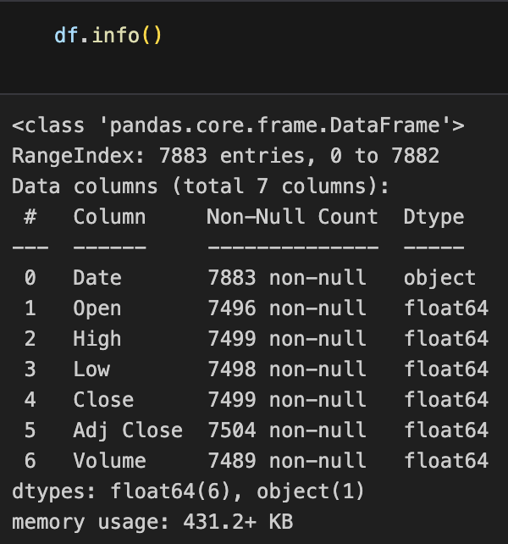
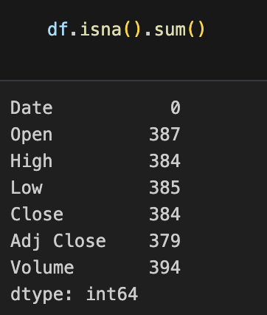
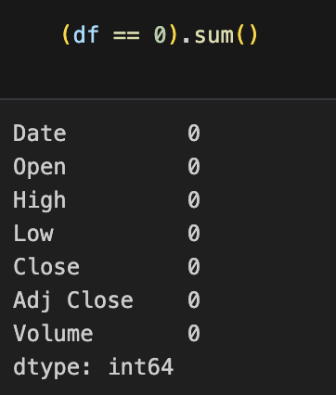
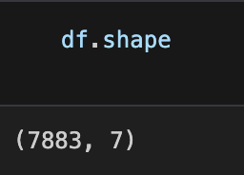
2.2. Inspect Data Frame
We followed a 6-step process to inspect the data frame for each dataset
Step 1.
Step 2.
Step 3.
To quickly preview the first few rows of a data frame.
To get a summary of key statistics for numerical columns.
To check the structure, data types, and missing values.
Step 4.
Step 5.
Step 6.
To check the number of rows and columns.
To count the number of missing values in each column.
To count the number of zero values in each column.

Slide 9
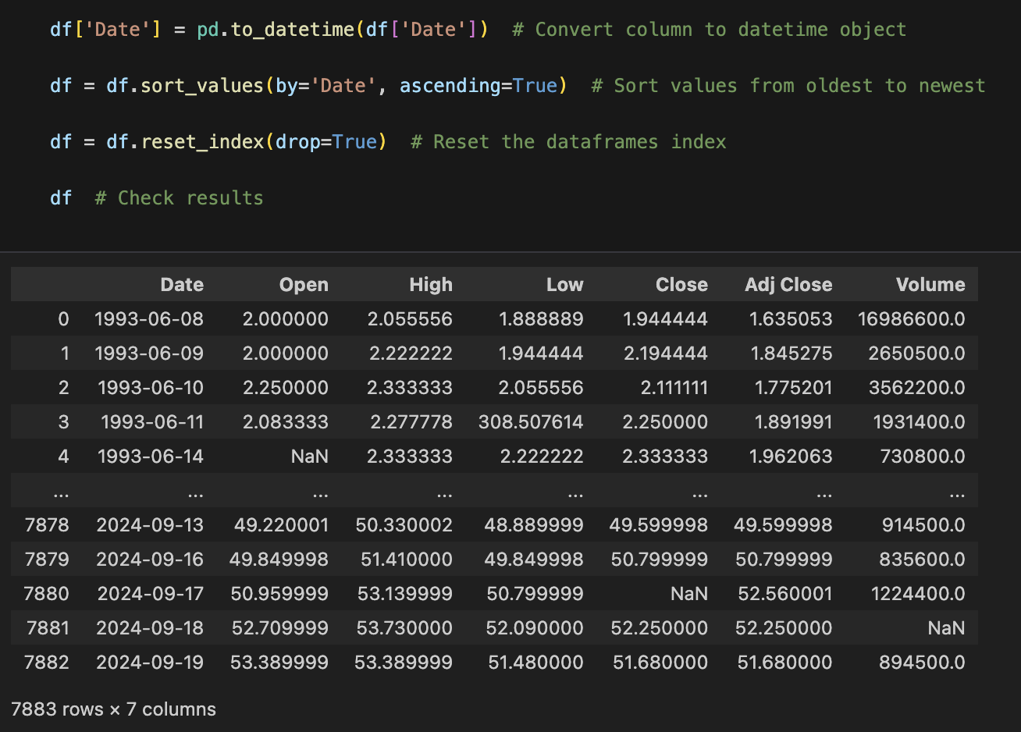
2.3.1. Sort Data
As the data is not sorted by the dates, we implement this as basis for all following steps.

Slide 10
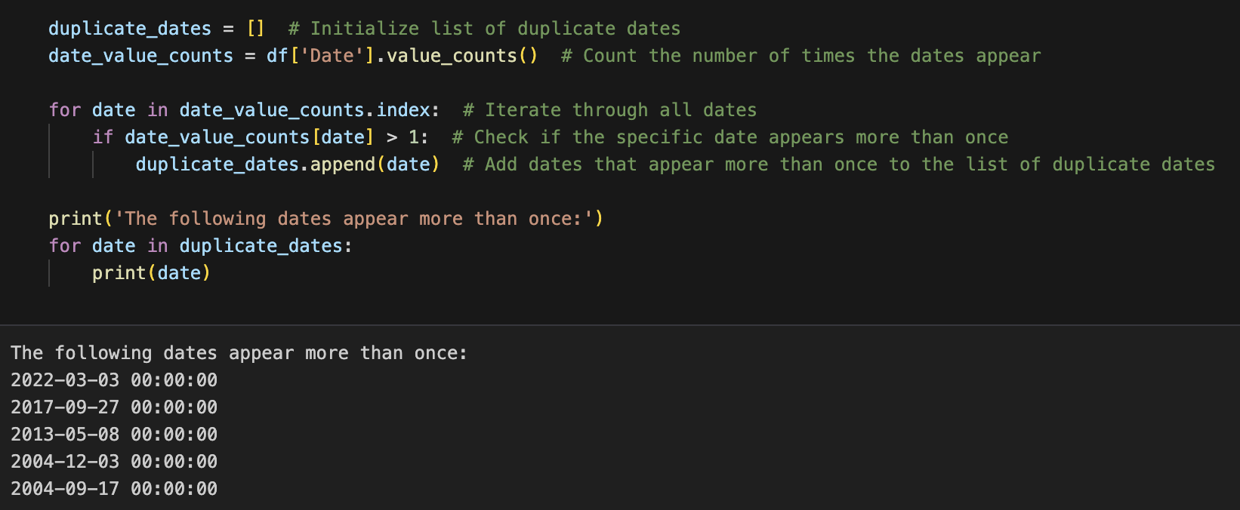
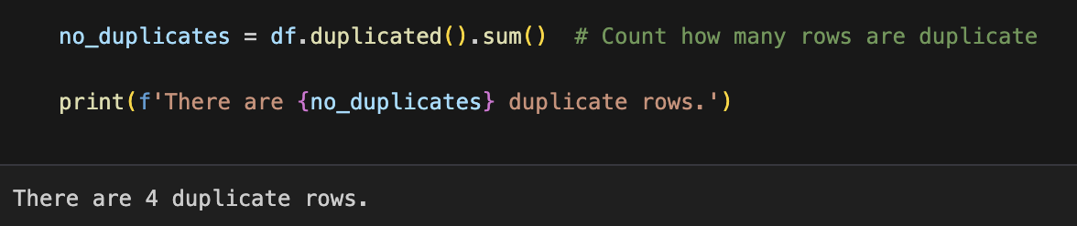
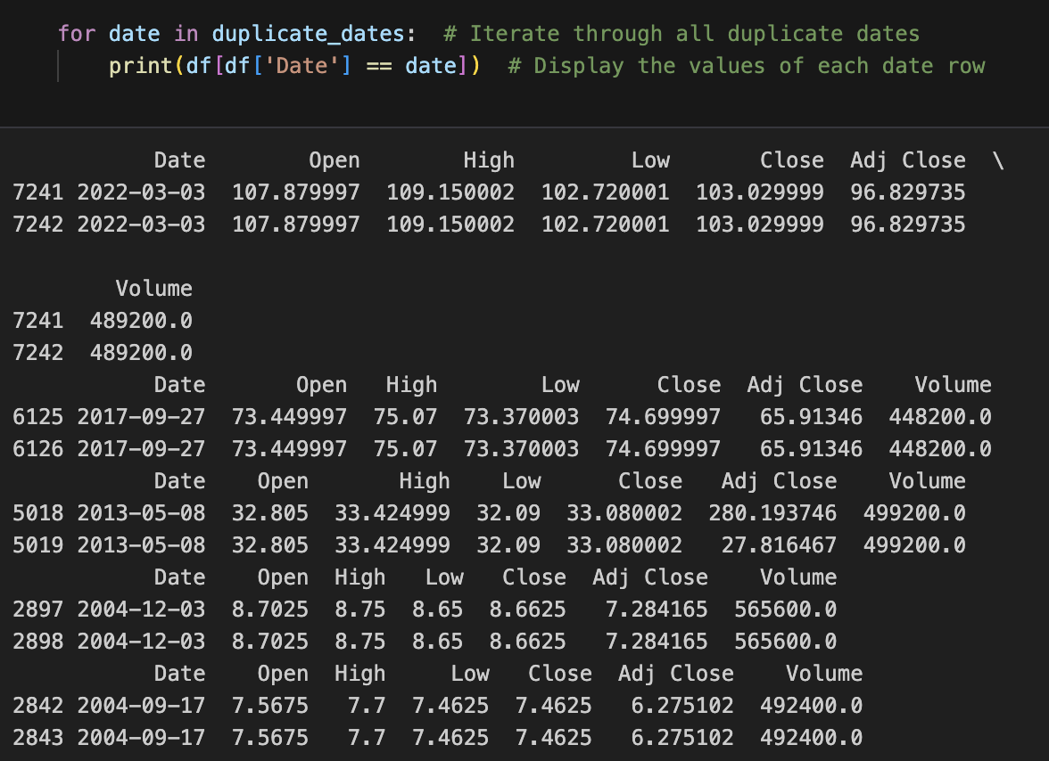
2.3.2. Identifying & Removing Duplicates
About duplicates
Step 1.
Step 2.
We start by identifying duplicate dates for each dataset.
Then, we check if the values are same for duplicate rows.
Step 3.
Upon further inspection, only 2 rows have entirely duplicate values. This means we must check each row of duplicate dates to see why this discrepancy appears.

Slide 11
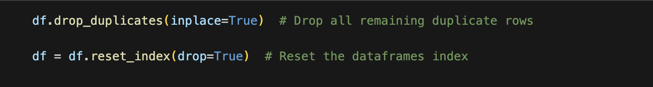
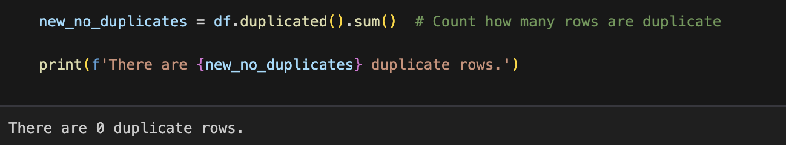
2.3.2. Identifying & Removing Duplicates
About duplicates
Step 4.
Step 5.
Based on our understanding from step 3, we identified the rows with certain values as outliers. Hence, we go ahead and manually remove these rows.
Then, we remove the remaining outliers and reset the index.
Step 6.
Finally, we check the results to confirm we have no duplicate rows left.

Slide 12
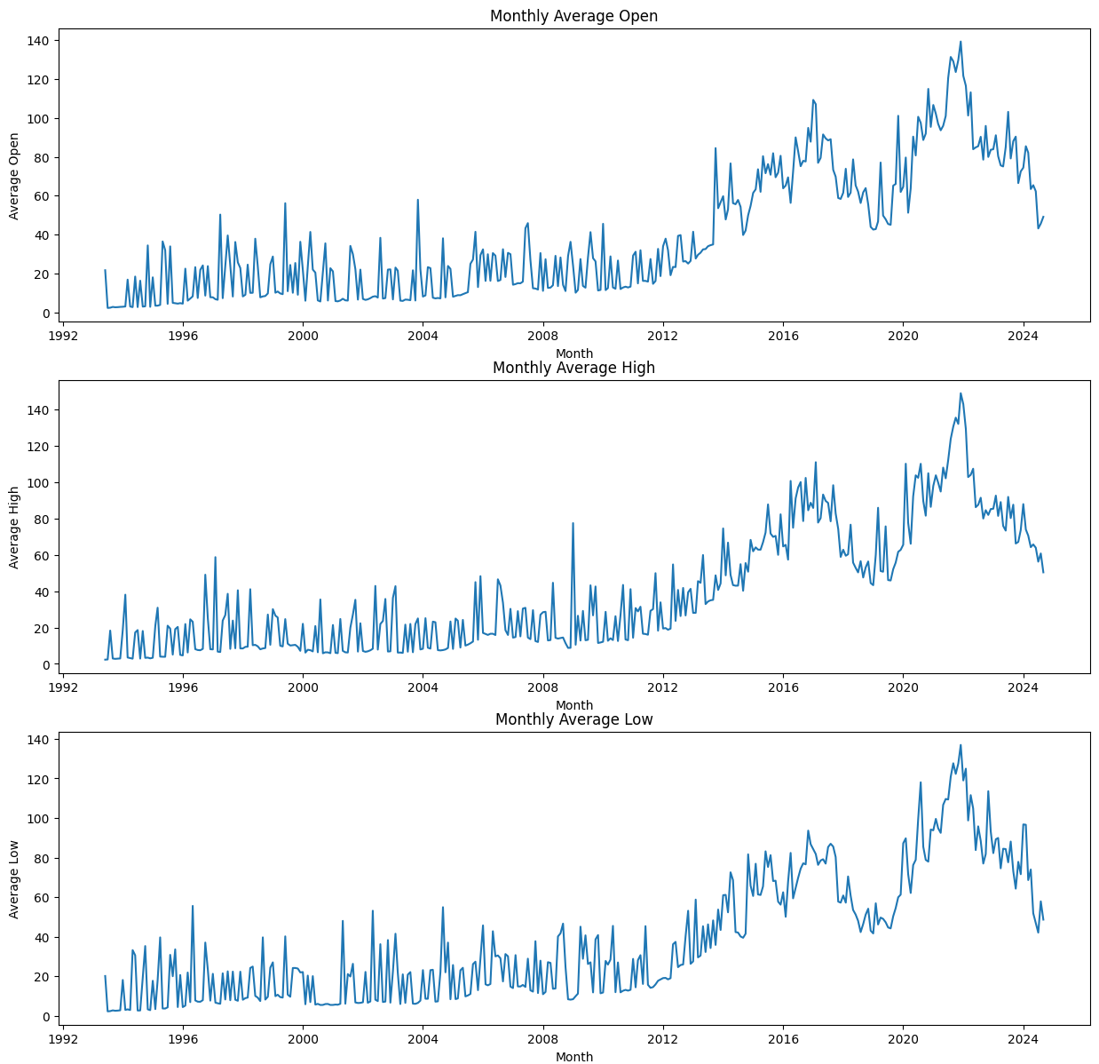
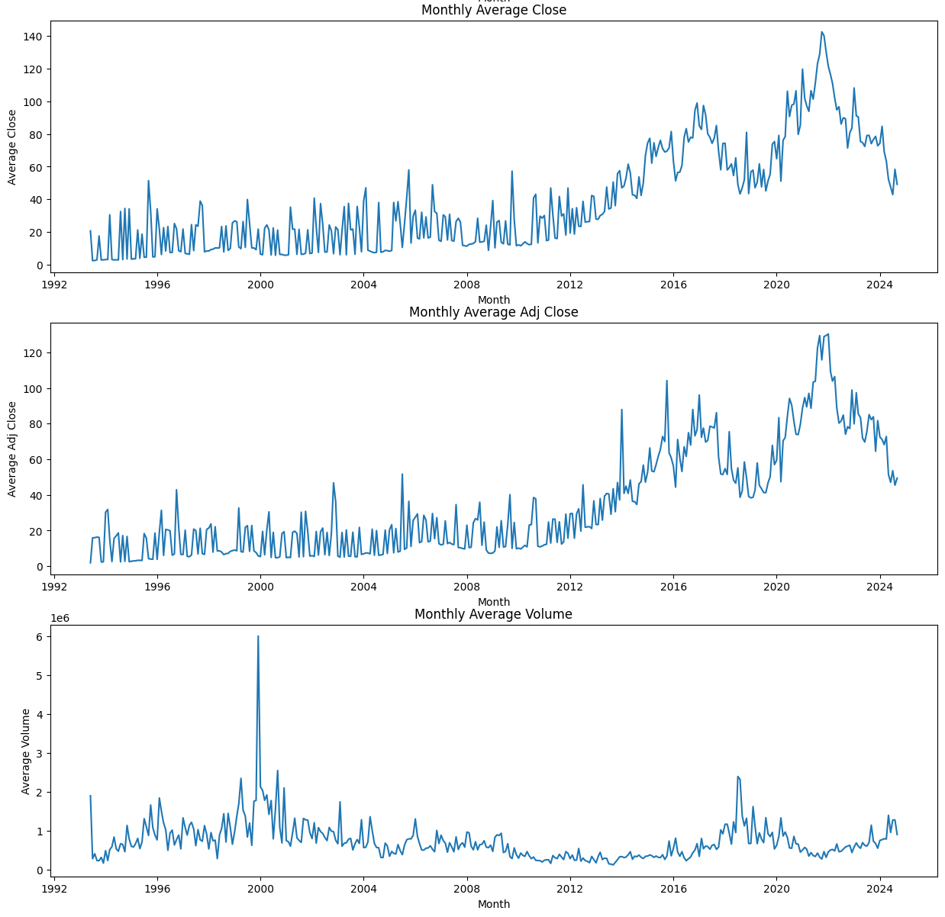
2.3.3. Visualize Data
To determine which data cleaning steps to take next, we visualize the stock development data:
Insights:
After calculating and grouping the average monthly open and close prices, we can see the plotted stock development.
It seems that there are some outliers in peaks and some zeros.

Slide 13
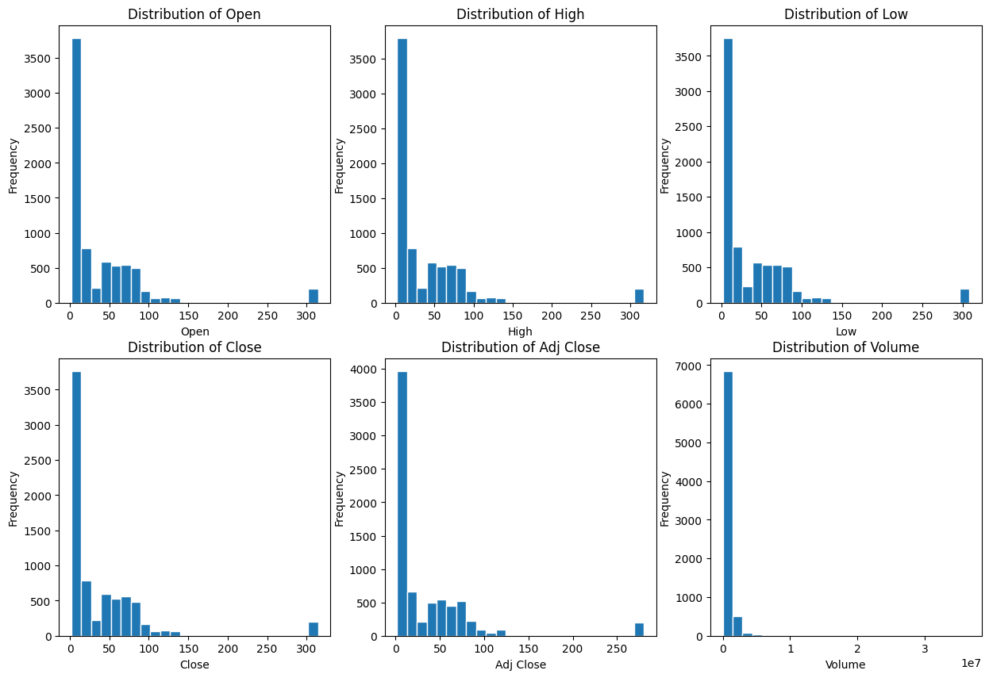
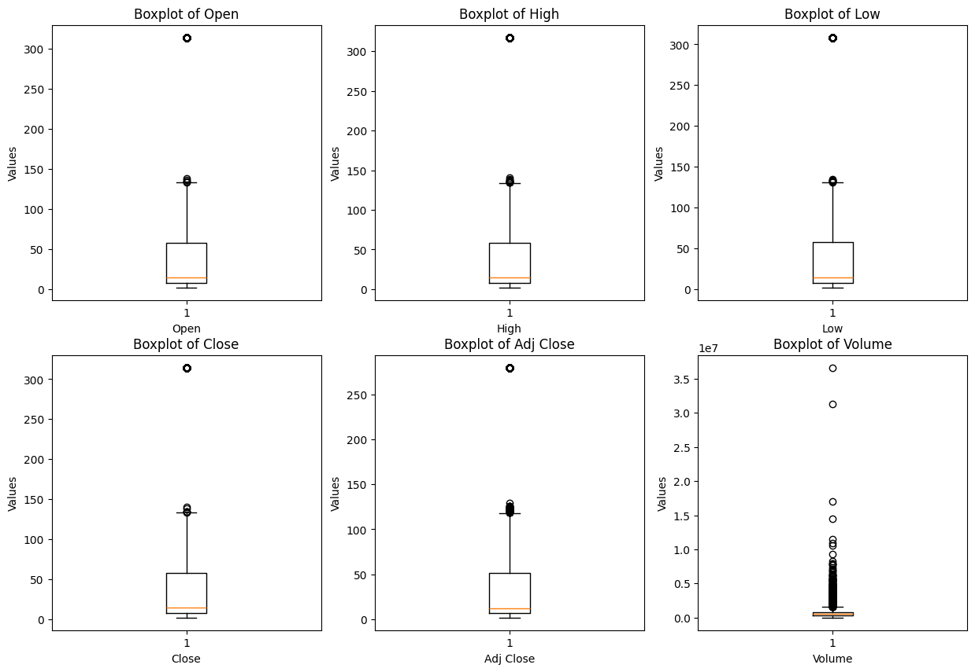
2.3.3. Visualize Data
We plot Histograms and Box Plots to further strengthen this assessment:
Histograms
Box Plots
Insights:
These histograms underline the previous assumptions on outliers.
The box plots highlights the outliers as well, helping us decide on the next steps required to clean the data.

Slide 14
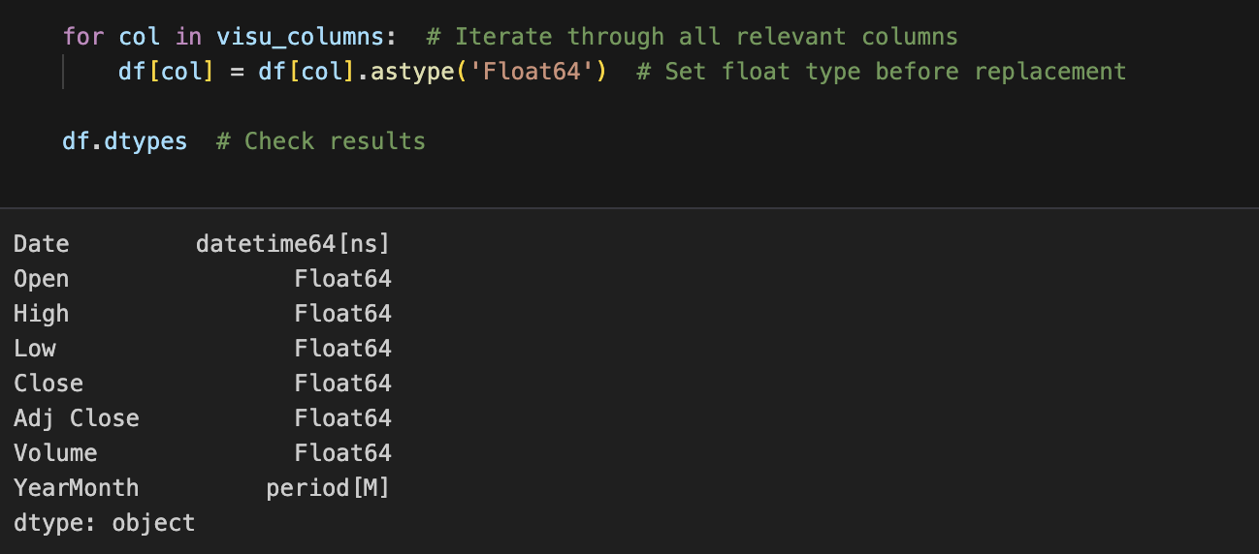
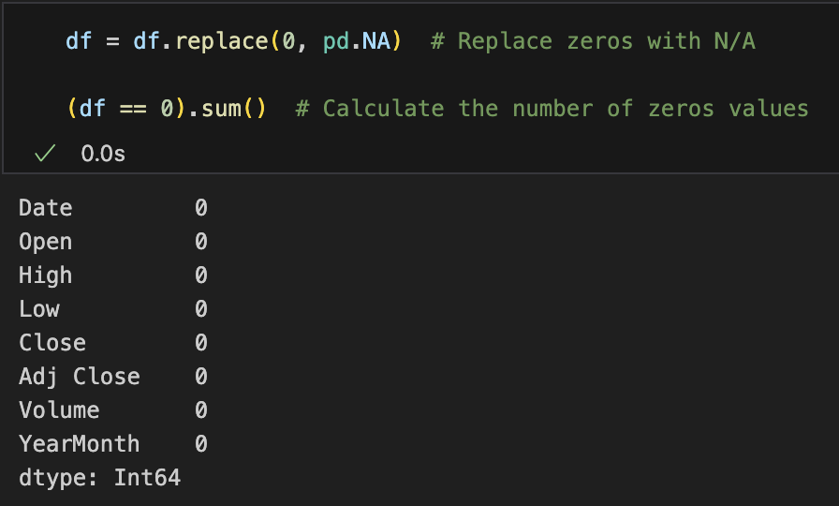
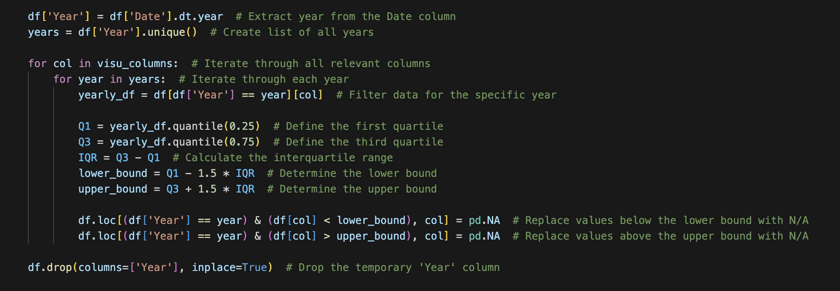
2.3.4. Removing Outliers
We usually took a 3-step approach to remove outliers.
Step 1.
Step 2.
We ensure consistent float data type in relevant columns before processing.
Based on the data visualization we decided to convert all zero values to N/A to impute them later. (In this case for PZZA there weren’t any 0 values – screenshot is from BRK-A)
Step 3.
*
We replaced all other outlying values with N/A using the Interquartile Range method on a yearly basis.

Slide 15
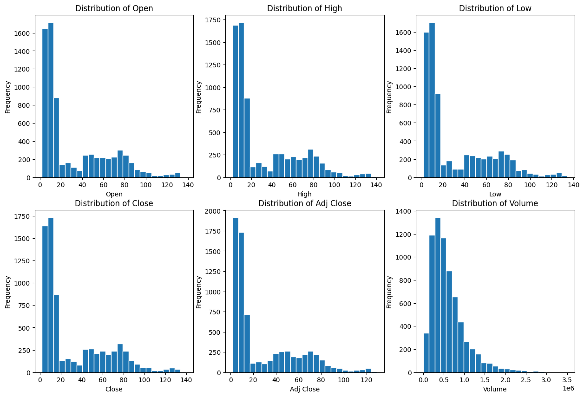
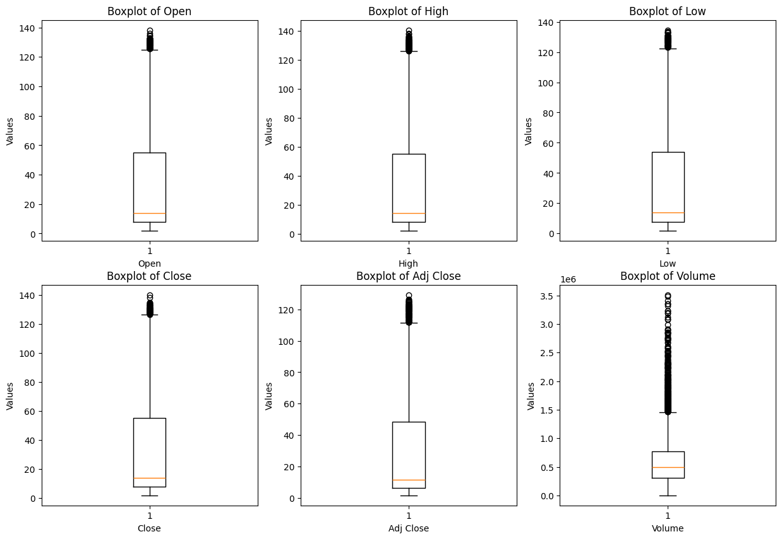
2.3.4. Sanity Check
After replacing all outliers, we check our results through another histogram and boxplot:
Histograms
Box Plots
Insights:
It appears that we have successfully removed all significant outliers.
In some cases we had to still remove outliers manually, because they weren’t detected by yearly IQR for being very old and out of proportion (see appendix).

Slide 16
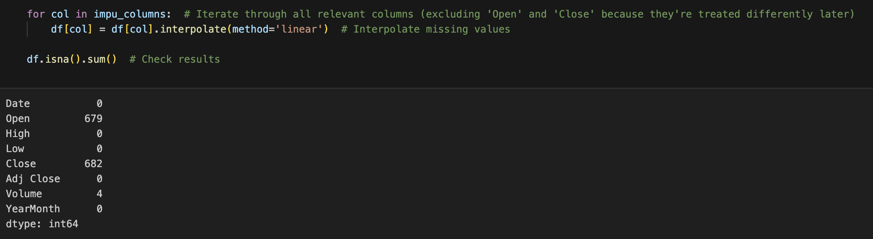
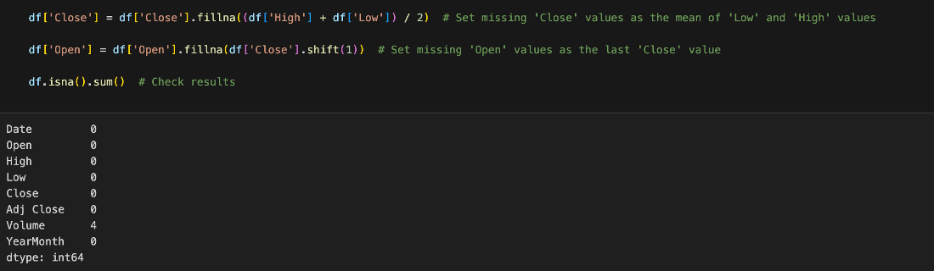
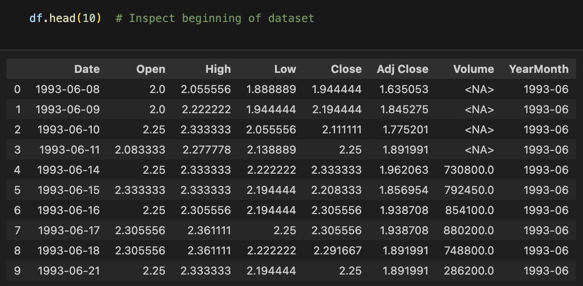
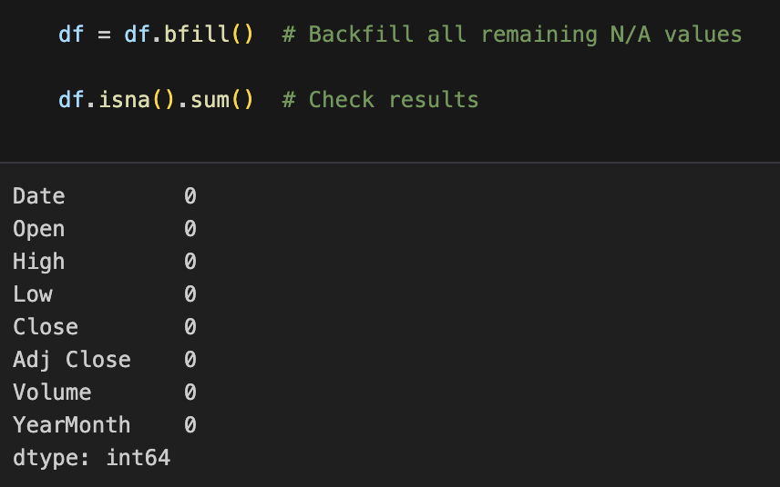
2.3.5. Impute Missing Values
About imputing missing values…
Step 1.
We first define the relevant columns for imputing.
Step 2.
Step 3.
Interpolate values for the set columns using the linear method.
We chose to take the mean of the last value and next non-missing value as imputation,
as it makes sense in the context of share prices.
Step 4.
Step 5.
After replacing all 'Open' and 'Close' values, there are sometimes still N/A’s remaining.
As these cases are always in the beginning of the respective column, we backfill them.

Slide 17
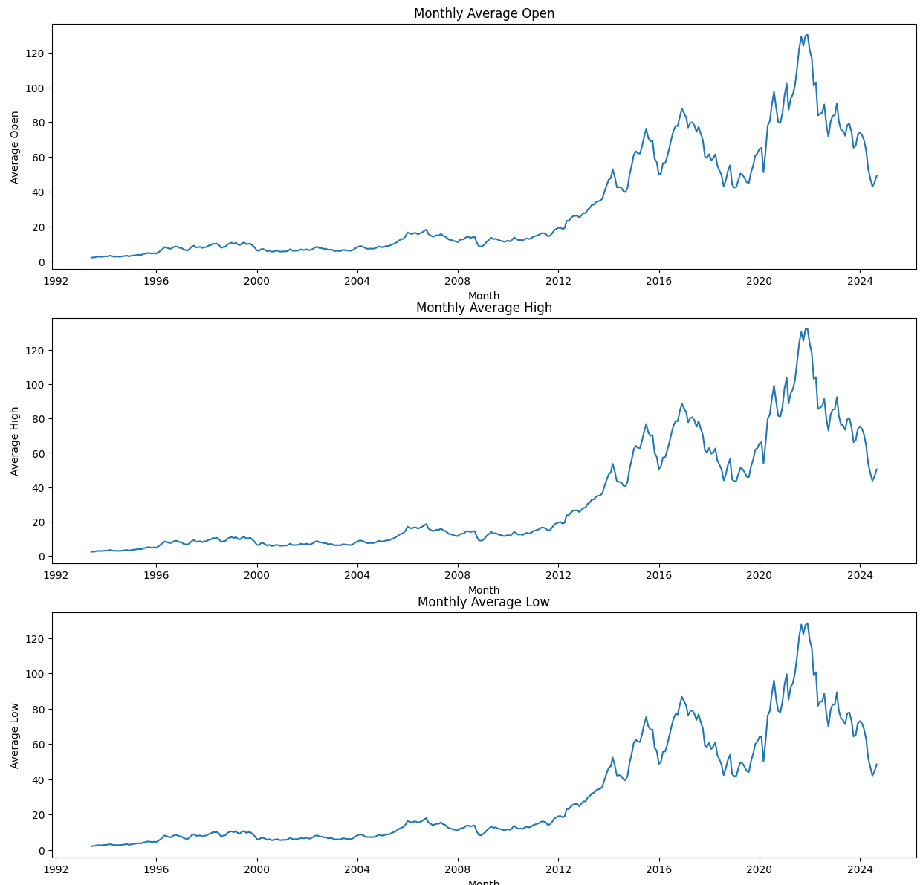
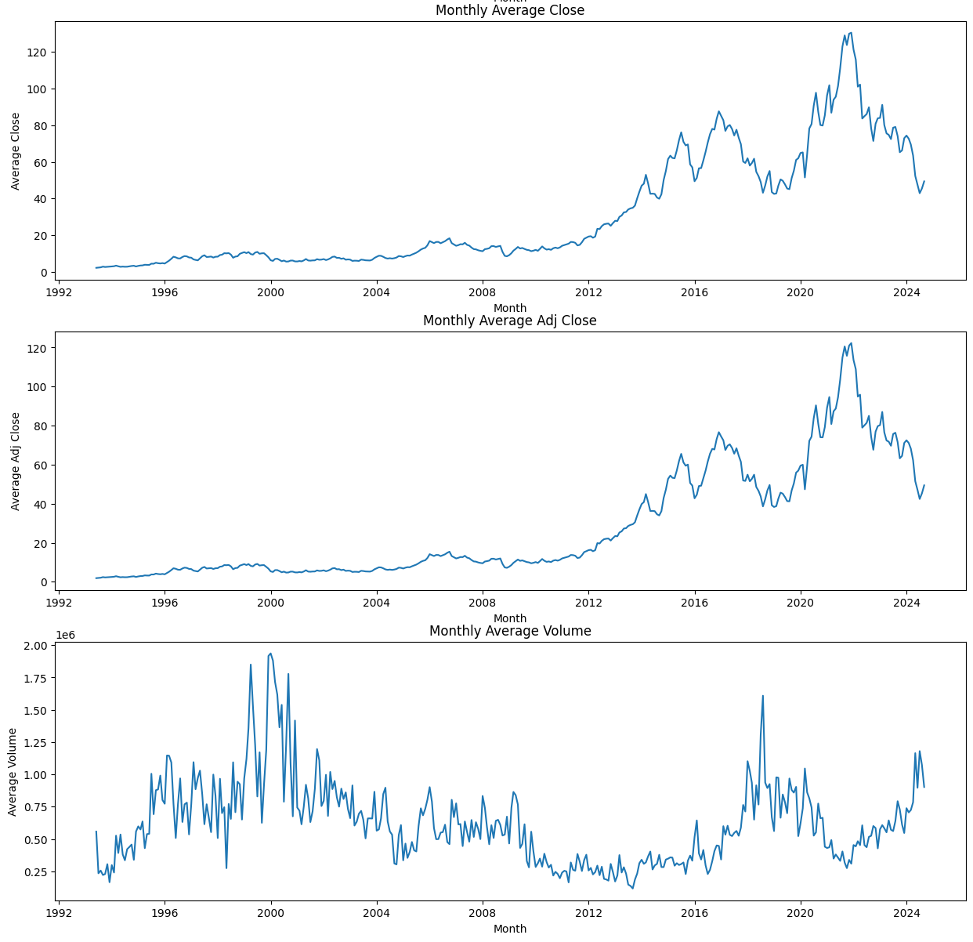
2.3.5. Final Sanity Check
We plot the stock developments to do one last check:
Insights:
The developments look reasonable in their respective context and don't seem to include outliers. Therefore we successfully conclude the data cleaning.

Slide 18
2.4. Export Dataset
We export the cleaned .csv dataset to the folder of cleaned datasets in our repository to access later.

Slide 19
3. List of Exercises
3.1. Exercise 1
3.2. Exercise 2
3.3. Exercise 3
3.4. Exercise 4
3.5. Exercise 5
3.6. Exercise 6
3.7. Exercise 7
3.8. Exercise 8
3.9. Exercise 9
3.10. Exercise 10

Slide 20
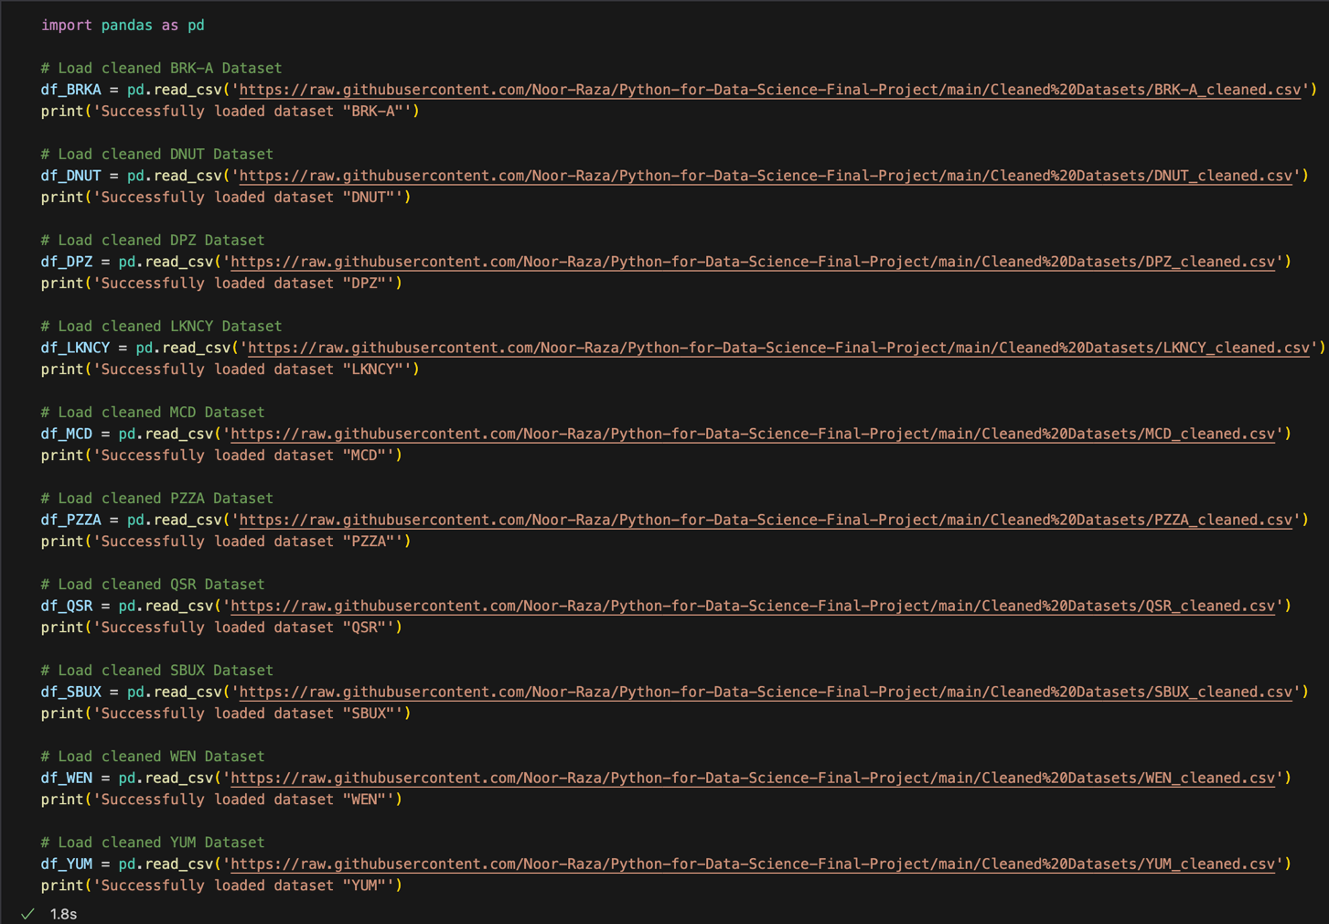
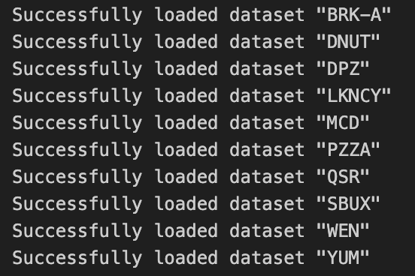
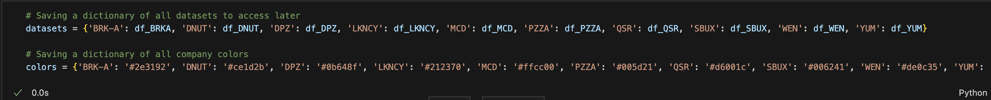
3. List of Exercises
Step 1. Importing cleaned dataset
Code
Output
Step 2. Stored datasets and corresponding company colours as dictionaries for consistent referencing later in the project

Slide 21
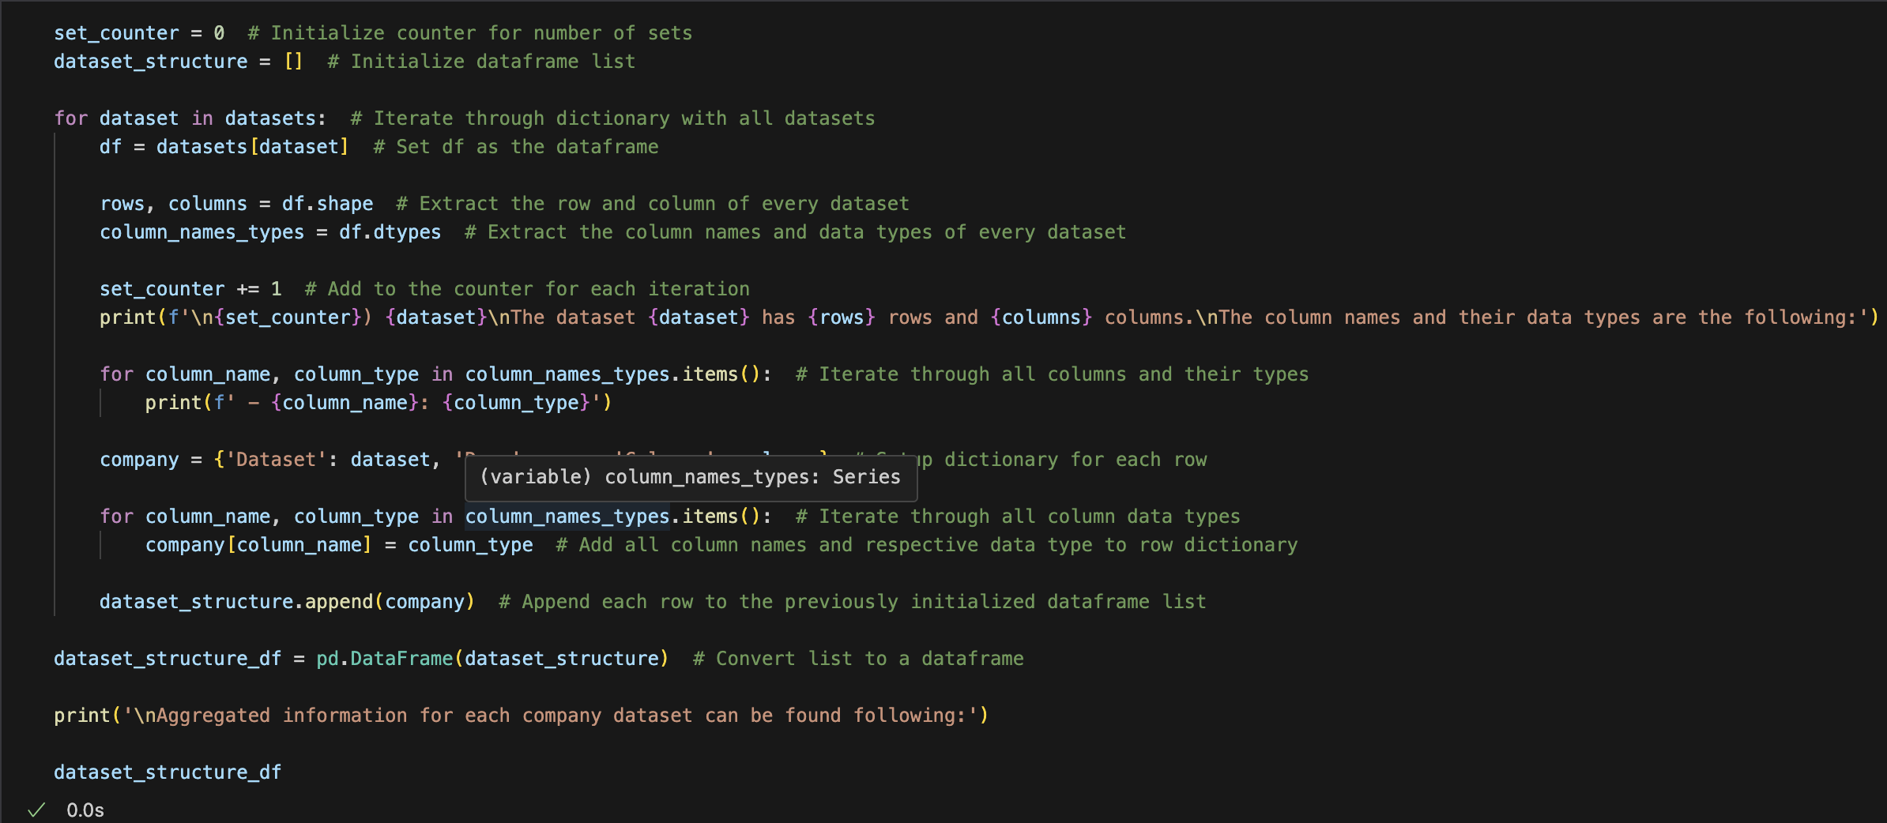
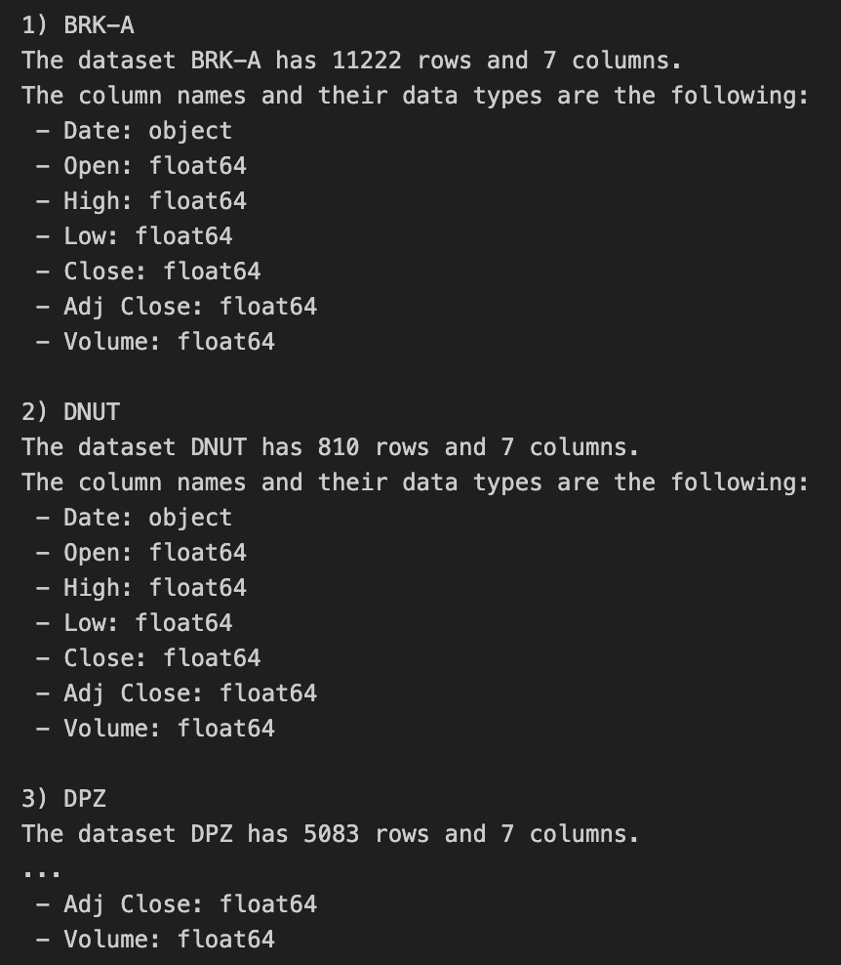
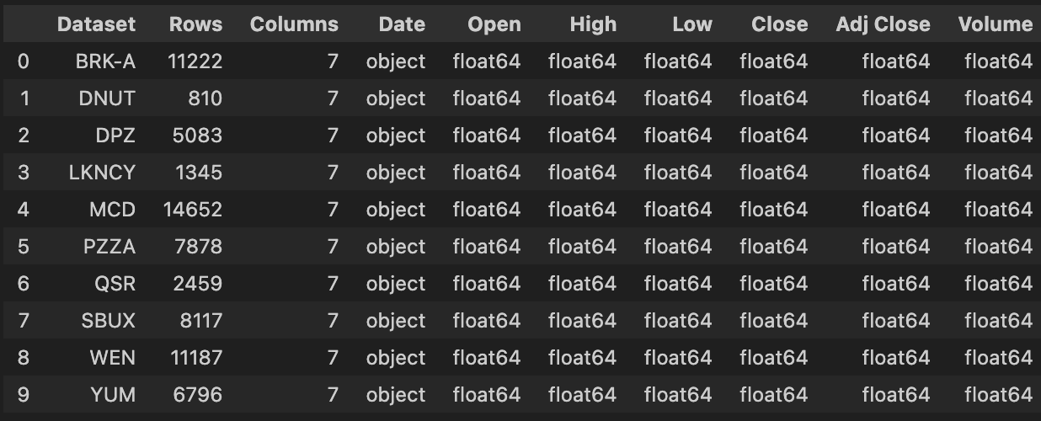
3.1. Exercise 1
1. Goal:
Print the number of rows and columns for each dataset. Display the column names and their data types for each dataset.
2. Approach:
We initialize set_counter at 0 to track the number of processed datasets.
Then, we loop through the datasets dictionary, where each key is the dataset name, and the value is its DataFrame.
For each dataset, we:
Set the DataFrame: We grab the current DataFrame and assign it to df so we can work with it directly.
Get its shape: We use .shape to determine how many rows and columns the DataFrame has.
Inspect column data types: Using .dtypes, we get information about each column's name and data type.
Then, we increment the set_counter by 1 to reflect that we're processing the next dataset.
3. Code:
4. Output:

Slide 22
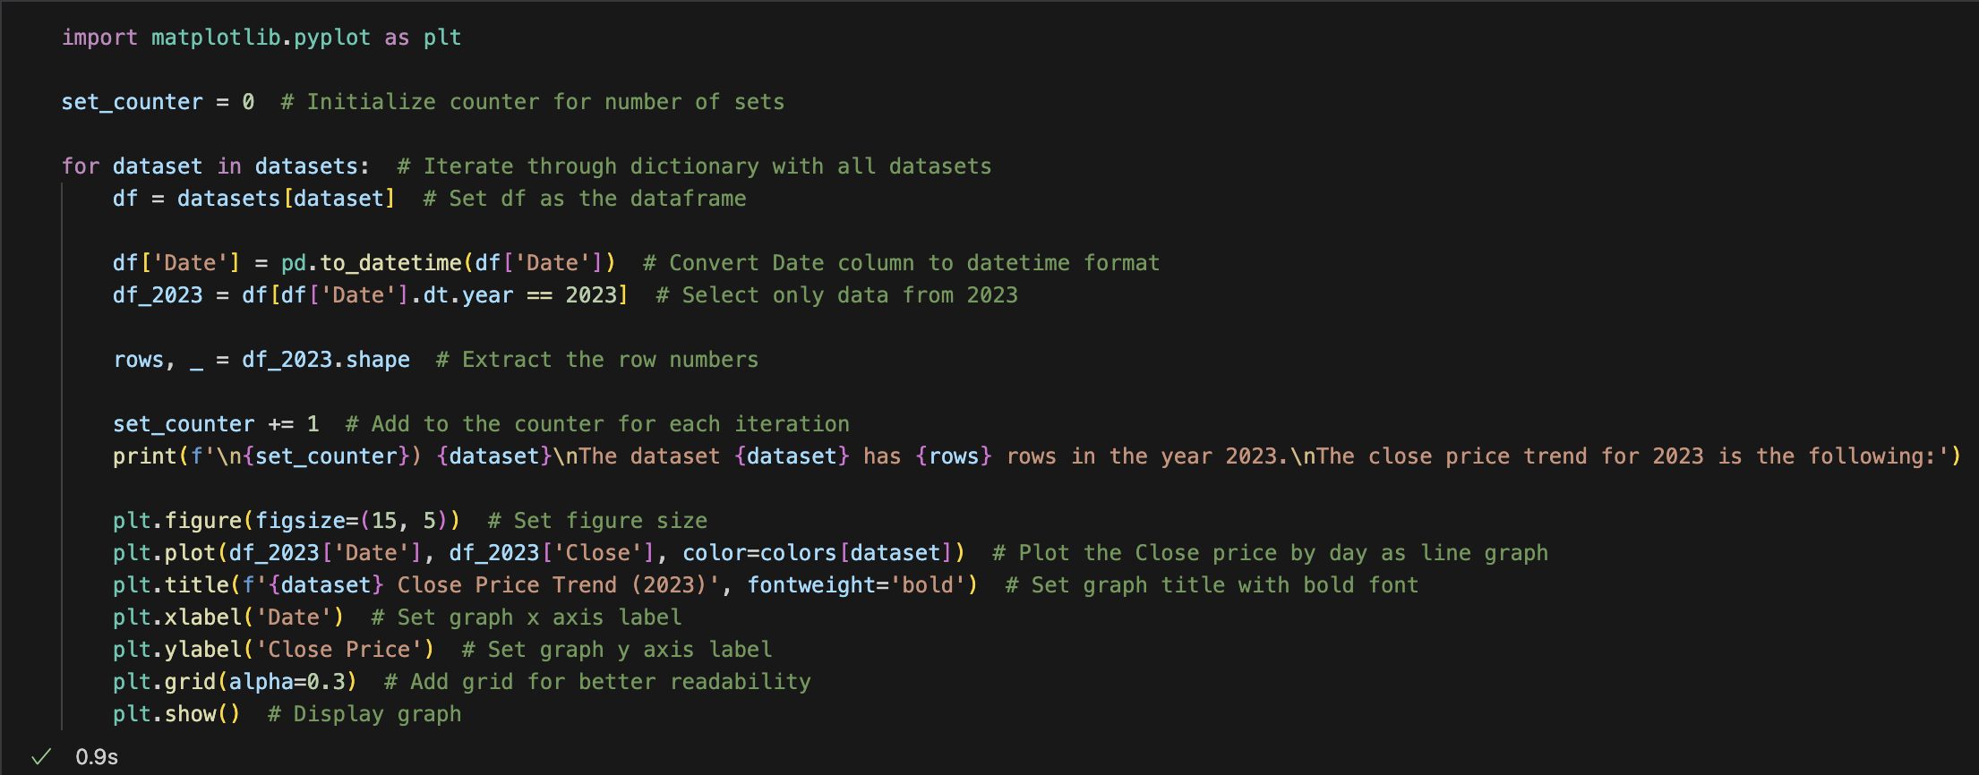
3.2. Exercise 2
1. Goal:
Extract all rows where the date is in the year 2023. Print the number of rows and visualize the Close price trend for this period.
2. Approach:
We initialize set_counter at 0 to track the number of processed datasets.
Then, we loop through the datasets dictionary, where each key is the dataset name, and the value is its DataFrame.
For each dataset, we:
Set the DataFrame: We grab the current DataFrame and assign it to df so we can work with it directly.
Get its shape: We use .shape to determine how many rows and columns the DataFrame has.
Inspect column data types: Using .dtypes, we get information about each column's name and data type.
Then, we increment the set_counter by 1 to reflect that we're processing the next dataset.
3. Code:

Slide 23
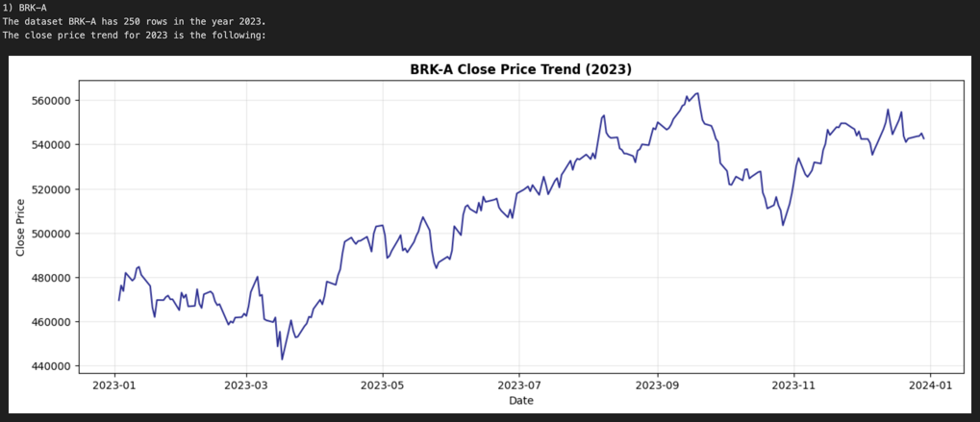
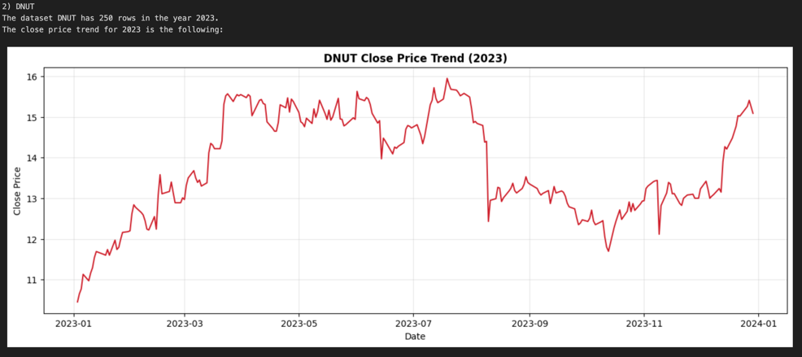
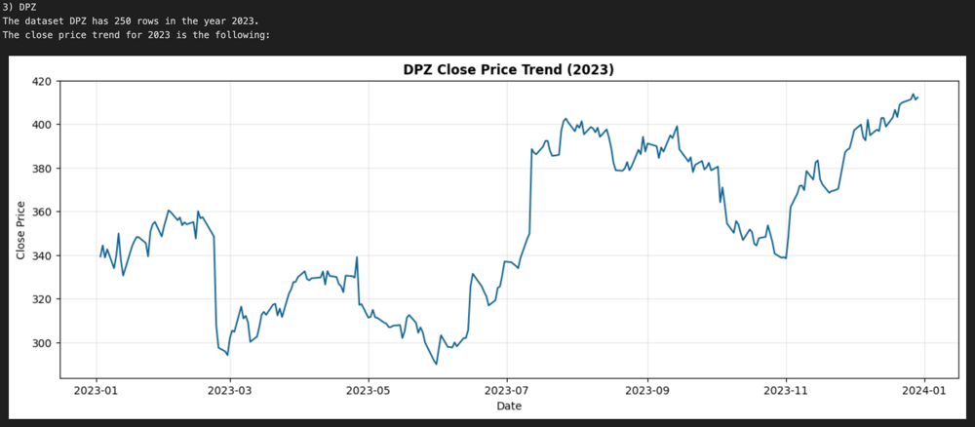
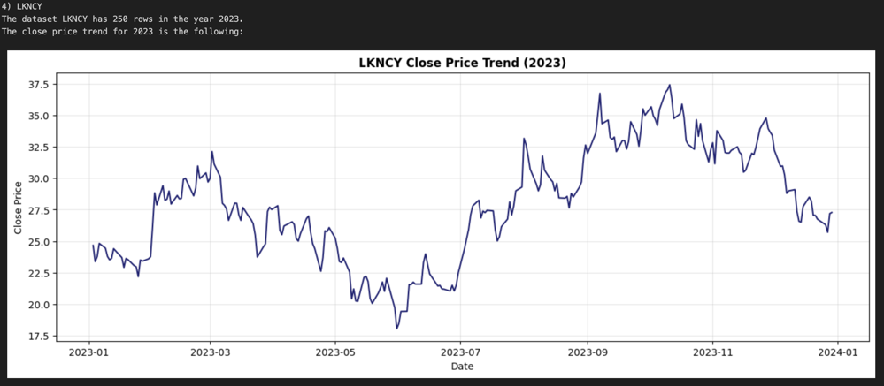
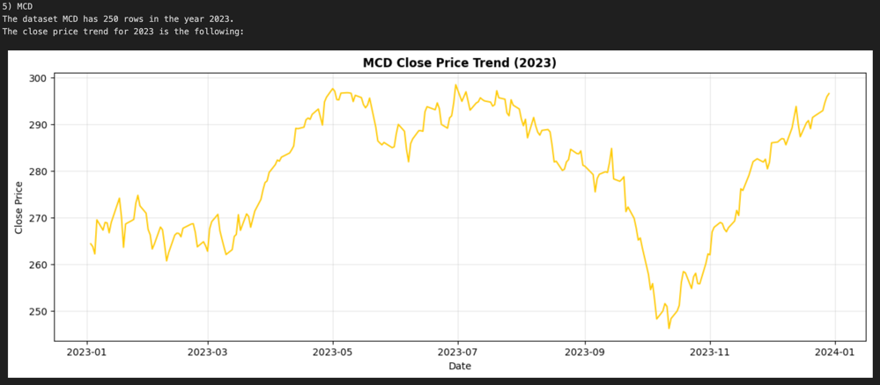
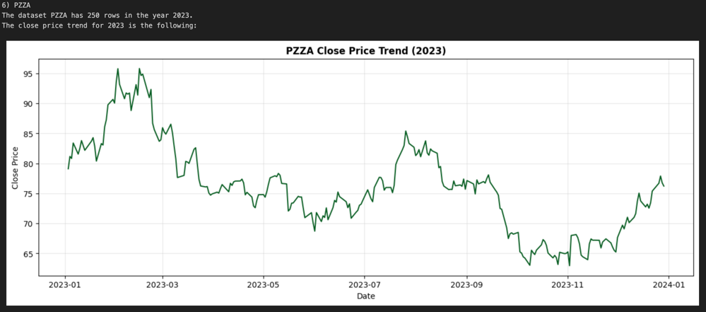




3.2. Exercise 2
4. Output:
5. Factors taken into consideration:
Visualization: A line chart was used to plot the "Close" prices against the dates, showcasing the daily price movements throughout the year.
Unique colours from the colours dictionary were used for each dataset, ensuring visual distinction between datasets.
A light grid was added to improve readability and assist in analysing specific values on the graph.
Separate charts for each dataset allow for detailed inspection of individual trends without overcrowding.

Slide 24



3.3. Exercise 3
1. Goal:
For each company, find the day with the highest Close price and display it alongside the price.
2. Approach:
We initialize set_counter at 0 to track processed datasets and an empty list, result, to store the outputs.
Then, we loop through the datasets dictionary, where each key is the dataset name, and the value is its DataFrame.
For each dataset:
Identify the highest Close price using .max().
Extract the row corresponding to this highest Close price.
Retrieve and format the date of this row for better readability.
Then, we increment the set_counter by 1 to reflect that we're processing the next dataset.
3. Code:
4. Output:

Slide 25


3.4. Exercise 4
1. Goal:
Group the data by month and calculate the average Close price for each company. Plot these monthly averages for 3 companies and compare them. Justify the chart selection.
2. Approach:
We initialize all_avg_close_month as a dictionary to store monthly average Close prices for all datasets. Then, we loop through the datasets dictionary, where each key is the dataset name, and the value is its DataFrame.
For each dataset:
Copy the DataFrame and add a Month column from the Date.
Calculate the average Close price for each month using .groupby() and store the result.
The results are converted into a DataFrame and rounded to two decimals. Next, we plot monthly average Close prices for selected companies (DPZ, SBUX, YUM), annotating each line and formatting the graph with titles, labels, and a grid for readability. The graph compares trends across companies over time.
3. Code:
a. Calculating Average Close Price
b. Plotting the Chart

Slide 26

3.4. Exercise 4
4. Output:
5. Justification of Chart Selection:
Shows trends over time: The line chart makes it easy to see how the average closing prices of the three companies have changed over the years.
Gives useful insights: The chart helps us understand which companies are growing faster and which are more steady, making it useful for planning or decisions.
Compares company performance: It clearly shows that DPZ has grown much more than SBUX and YUM, which have remained more stable.
Ensures Fair Comparison: We started the data from the point where all three companies had available data (2004), ensuring that the comparison is meaningful and consistent across the timeline.
Improves Readability: The gridlines and distinct colors for each company enhance readability, ensuring that the chart is easy to interpret.

Slide 27


3.5. Exercise 5
1. Goal:
Compute the yearly average of the Close price.
Plot a comparison of yearly averages for all companies on a chart. Justify your chart selection.
2. Approach:
We start with an empty dictionary all_avg_close_year to store yearly average Close prices for all datasets.
Key Steps:
Loop through datasets, create a copy, and add a Year column extracted from the Date column.
Group by Year and calculate the average Close price, storing results in a dictionary.
Convert the dictionary to a DataFrame, filter data to include years from 1980, and assign colors for each dataset.
Plot the filtered data with a logarithmic y-axis, customized labels, grid, and legend for clear visualization.
3. Code:
a. Computing Yearly Average Close Price
b. Plotting the Chart

Slide 28

3.5. Exercise 5
4. Output:
5. Justification of Chart Selection:
Highlights long-term trends: The chart effectively shows how companies have performed over the decades, helping to identify consistent growth patterns or stagnation.
Logarithmic scale improves readability: Using a log scale makes it easier to compare companies with widely varying stock prices over time, showing trends more clearly.
Compares company performance effectively: For instance, Berkshire Hathaway (BRK-A) shows a steady and significant increase over the years, far outperforming other companies, indicating its strong long-term performance.
Starting the Chart from 1980: Prior to 1980, data availability is limited to only one company. Starting the chart from 1980 ensures that the yearly comparison of average close prices includes data from multiple companies.

Slide 29


3.6. Exercise 6
1. Goal:
For each company create a plot showing the range of prices for each month and justify the chart selection.
2. Approach:
We initialize set_counter to track datasets and dictionaries to store monthly Close price ranges.
For each dataset, we:
Copy the DataFrame, add a Month column, and calculate monthly max/min Close prices.
We increment set_counter and print details about each dataset.
For plotting, we used two approaches:
Line Plot: Shows monthly highs and lows with a shaded area, emphasizing trends over time.
Box Plot: Captures monthly Close price variability and outliers, focusing on data spread.
3. Code:
a. Part 1
b. Part 2

Slide 30










3.6. Exercise 6
4. Output 1:
5. Justification of Chart Selection:
We chose line charts to display the monthly range of Close prices for each company, as this visualization is well-suited for representing the data's key characteristics.
Visualizes Trends Over Time: The line plot clearly shows how high and low prices change month by month, helping to identify long-term patterns or sudden shifts.
Shows Variations Clearly: A line chart effectively captures the highs and lows of Close prices for each month, highlighting the range and providing a clear view of fluctuations within the time frame.
Facilitates Range Visualization: The size of the filled area between highs and lows shows periods of stability or high volatility, helping us spot trends over time.
Focus on Extremes: Emphasizing the highs and lows helps identify months with significant price movements, which might indicate market events or company-specific changes.

Slide 31










3.6. Exercise 6
6. Output 2:
7. Justification of Chart Selection:
We chose box plots to display the range of Close prices for each month because this chart type is specifically suited to represent the distribution and variability of data:
Represents the Data Range Clearly: Box plots provide a concise statistical summary of the distribution of Close prices for each month.
Highlights Outliers: This chart type is particularly effective in identifying outliers, which can be critical in stock price analysis to understand unusual fluctuations or anomalies.
Compact Representation: Box plots summarize a large amount of data in a visually straightforward way, making them ideal for analyzing the range of prices over multiple months without overwhelming the viewer.
Time Range: As boxplots take up a certain amount of space on the chart to be easily readable, we are not able to plot the entire history of data. Therefore we have decided to choose the last two years to give a detailed boxplot explanation while still maintaining interpretability.

Slide 32


3.7. Exercise 7
1. Goal:
Create a plot showing the relationship between trading volume and the Close price for a selected company. Add insights about the pattern, and, justify your chart selection.
2. Approach:
We focused on the DNUT dataset by selecting the company's data from the datasets dictionary.
Fit a linear regression model between Volume and Close price using np.polyfit to compute the regression line.
Calculate the standard deviation of residuals (differences between actual and predicted values) to understand data variability.
Compute the correlation coefficient to showcase the relationship between Volume and Close.
Use Seaborn's joint plot to visualize the relationship between Volume and Close with scatter points.
Add the regression line, ±1 standard deviation lines, and correlation information to the plot.
3. Code:
a. Part 1
b. Part 2

Slide 33

3.7. Exercise 7
1. Output:
3. Insights:
Volume Concentration: The marginal histogram for the trading volume shows a high concentration of data points around the lower volume range (below 1 million), indicating that most trading activity happens within this range, which makes sense in the context of usual stock market trading.
Price Stability: The Close price shows limited variability, with most values clustering between $12 and $15. This suggests relatively stable pricing over the observed period, even with varying trading volumes.
Outlier Detection: The scatter plot reveals some outliers where trading volume exceeds 3 million, and Close prices drop below $12. These outliers could indicate significant market events or anomalies, such as the Covid-19 pandemic or 2008 financial crisis.
Lack of Strong Trend: The overall scatter pattern suggests no strong or consistent relationship between trading volume and Close price, implying that factors other than volume might influence the stock price.
2. Justification of Chart Selection:
DNUT was selected because it has an interesting pattern with relatively low correlation and high density of data points. We chose a scatter plot embedded in a joint plot together with two histograms to visualize the relationship between trading volume and the Close price for the selected company for the following reasons:
Highlights the Relationship: A scatter plot is the best choice for visualizing the correlation between two continuous variables (trading volume and Close price), making it easy to identify patterns or trends.
Marginal Distributions: The histograms on the top and right display the accumulated distribution of volume and close price in buckets, giving additional context to the scatterplot.
Regression Line for Trend: The regression line provides a visual indication of the overall trend, even if the correlation is weak or non-existent.
Standard Deviation Bounds: The +1 and -1 standard deviation lines help identify the range of typical data variation.

Slide 34


3.8. Exercise 8
1. Goal:
For each company, identify the month with the highest total trading volume and display the results in a summary table, showing the month and total volume.
2. Approach:
We identify the month with the highest total trading volume for each company and compile the results into a summary table.
Key Steps Taken:
Loop through datasets, create a copy, and add a Month column derived from the Date.
Group data by Month and calculate the total trading volume.
Identify the month with the highest volume and its value, then format the month for readability.
Store results in a dictionary and convert it into a summary DataFrame.
3. Code:
4. Output:

Slide 35


3.9. Exercise 9
1. Goal:
Merge the datasets for all companies into a single dataset, one for each year.
Print the structure of the combined dataset, ensuring proper alignment and handling of missing values.
2. Approach:
We merge yearly data for all companies into a comprehensive dataset and analyse its structure.
Key Steps:
Extract relevant years from the data and store them in a list.
Loop through each year and filter data for all companies, adding it to a yearly dictionary.
Merge yearly dictionaries into a single multi-layered dataset with year and company indices.
Analyze the structure of the merged dataset, including row counts, column names, and data types for each year.
3. Code:
a. Part 1
b. Part 2

Slide 36




3.9. Exercise 9
4. Output:
a. Part 1
b. Part 2

Slide 37




3.10. Exercise 10
1. Goal:
Calculate the spread between the High and Low prices for each day
Compute the average spread for each company and visualize the result in a chart. Justify the chart selection
Interpret which companies exhibit the largest spreads and why this might happen
2. Approach:
We Analyse and compare the average spread between high and low prices for each company and visualize trends overall and for the last 5 years.
Key Steps:
Calculate the spread (High - Low) for each dataset and compute the average spread as a percentage of the midpoint.
Group data by month to calculate monthly average spreads for all companies.
Filter data to focus on spreads for the last 5 years.
We plot a Bar Chart to compare average spreads across all companies using a bar chart.
A Line Chart (Overall) to plot monthly average spreads over the entire period for long-term trend analysis.
Another Line Chart (Last 5 Years) to highlight monthly average spreads for the past 5 years to emphasize recent trends.
3. Code:
a. Part 1
b. Part 2
c. Part 3

Slide 38

3.10. Exercise 10
1. Output:
3. Insights:
LKNCY has the highest average spread, indicating significant price volatility.
BRK-A has the smallest average spread, suggesting more stable pricing.
Other companies fall between these two extremes, showing moderate variability.
2. Justification of Chart Selection:
Bar Chart was used for comparison of Total Average Spreads by Company
Purpose: Highlights the total average spread for each company in a straightforward manner.
Why Used: Makes it easy to compare spreads across companies at a glance.
Key Focus: Identifies which companies have the largest and smallest average spreads throughout their history.

Slide 39


3.10. Exercise 10
4. Output:
6. Insights:
Significant spread spikes are noticeable during financial crises or company-specific events.
BRK-A consistently maintains low spreads, while LKNCY and others show periodic large spikes.
The pandemic (2020) caused temporary high spreads for many companies, with LKNCY being notably volatile.
Post-pandemic trends indicate stabilization for most companies but with occasional fluctuations.
7. Why LKNCY has the highest Average Spread?
LKNCY's sharp rise in spreads during 2020 was driven by COVID-19 market instability, reduced liquidity, and its post-IPO volatility.
Despite some stabilization, LKNCY still shows higher fluctuations (~5%), reflecting market sensitivity and speculative trading.
High market risks and uncertainties contribute to LKNCY’s continued price volatility.
Low trading volumes increase bid-ask spreads, as fewer market participants trade LKNCY's stock.
5. Justification of Chart Selection:
Line Chart: Monthly Average Spread by Company (Overall)
Purpose: Tracks the changes in monthly average spreads over a long period.
Why Used: Provides a historical view of spread trends and helps detect long-term patterns.
Key Focus: Highlights fluctuations, peaks, and trends in spreads over decades.
Line Chart: Monthly Average Spread by Company (Last 5 Years)
Purpose: Zooms in on recent trends in monthly spreads for a more focused analysis.
Why Used: Captures short-term variability and recent behaviour in spreads.
Key Focus: Identifies recent trends, including volatility or stabilization.

Slide 40

Thank you!
Any questions?

Slide 41
Appendix

Slide 42



2.3.4. Removing Outliers (Edge Cases)
Manual removal of outliers not detected by yearly IQR.
Histograms
Box Plots
Removal:

Slide 43
Heading
Sub-heading
Step 1.
Step 2.
Step 3.
line
line
line
Step 4.
Step 5.
Step 6.
line
line
line

Slide 44
Heading
Sub-heading
Step 1.
Step 2.
line
line
Step 3.
line

Slide 45
Exercise
1. Goal:
goal
2. Approach:
approach
3. Code:

Slide 46
Exercise
1. Goal:
goal
2. Approach:
approach
3. Code:
4. Output:

Slide 47
Exercise
1. Goal:
goal
2. Approach:
approach
3. Code:
a. Part 1
b. Part 2

Slide 48
Exercise
1. Output:
3. Insights:
2. Justification of Chart Selection:

